Slide 1
Social Media fetcher

Slide 2
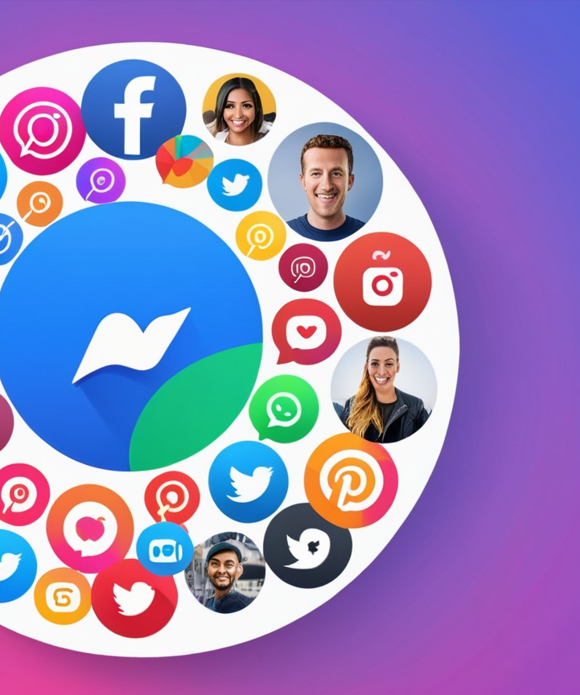
Main idea
A multi-platform social media fetcher that uses threads to aggregate, consolidate, and periodically refresh content into a unified feed.

Slide 3
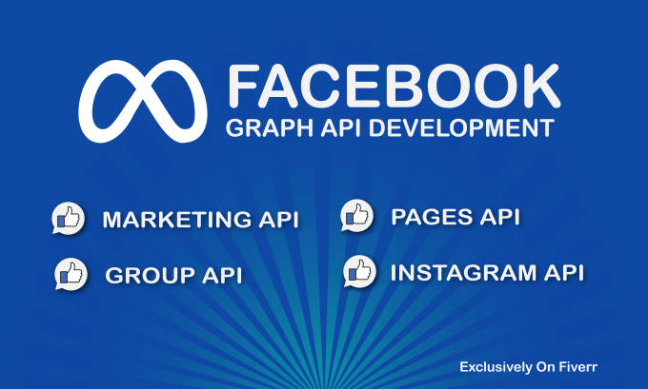
We used graph api by meta to fetch platforms apis
Platform Selection: Choose a specific social media platform and review its Graph API documentation.
API Access: Register your app on the platform, and obtain an App ID and App Secret.
Authentication: Use OAuth 2.0 to authenticate users and generate an access token with required permissions.
Data Fetching: Use Graph API endpoints with relevant parameters to retrieve the desired content.

Slide 4
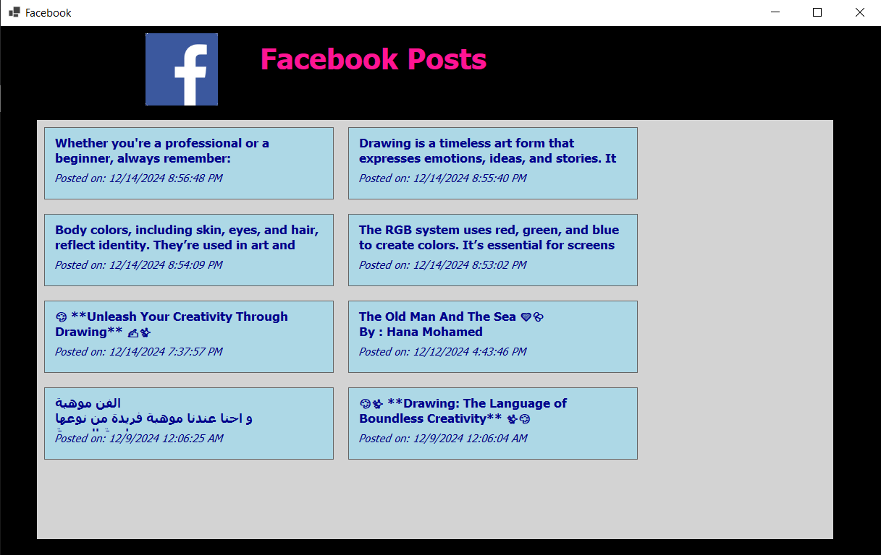
Api fetching from facebook platform
You can access your facebook page posts using url : https://graph.facebook.com/v21.0/{page_id}/posts?access_token={fb_page_access_key}

Slide 5
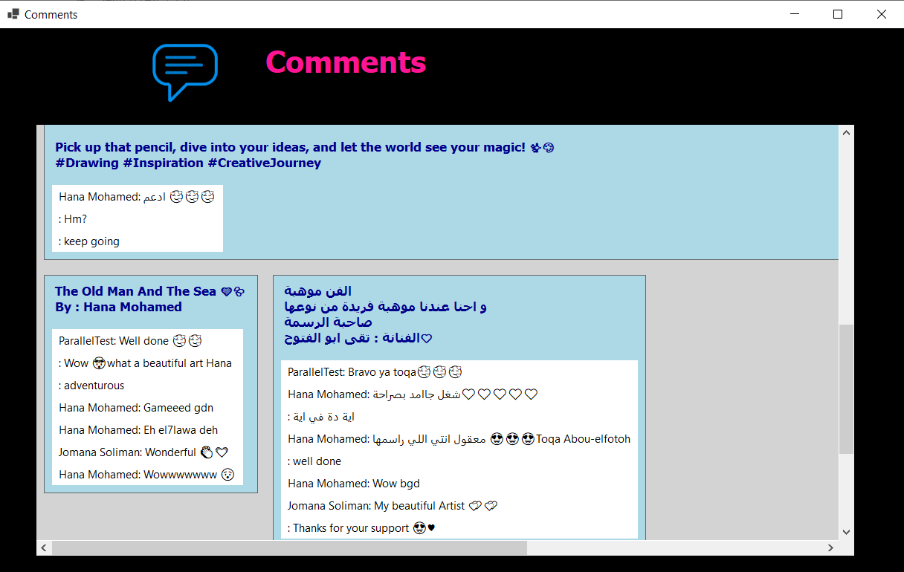
Facebook Comments fetching api
You can access facebook comments using url:
https://graph.facebook.com/v21.0/{post_id}/comments?access_token={fb_page_access_key}

Slide 6
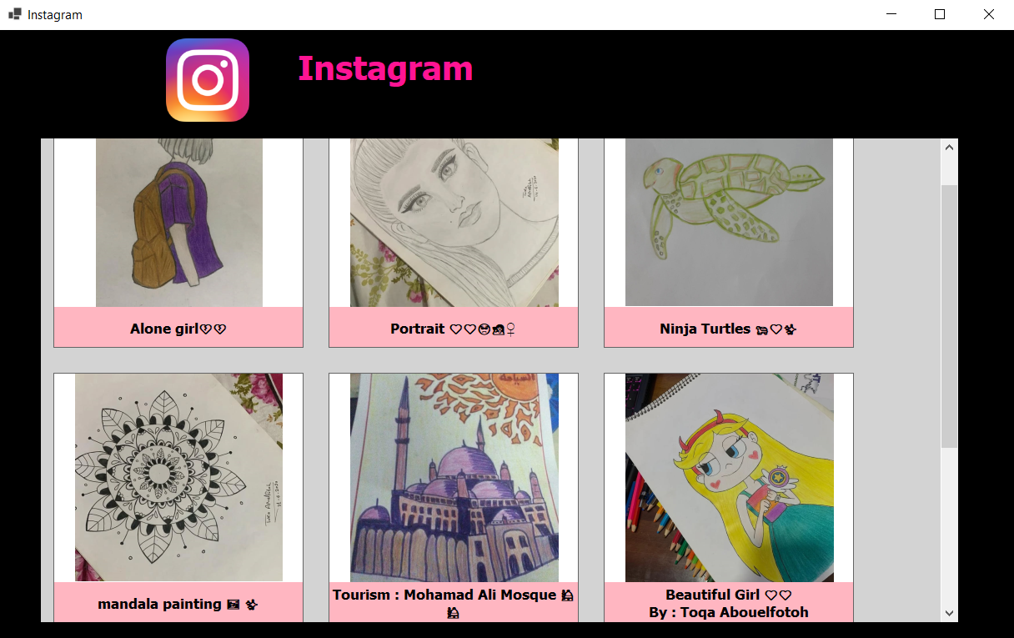
Api fetching from Instagram platform
Using your intagram account to access the posts , using your Instagram account access key
, url :
https://graph.instagram.com/me/media?fields=id,caption,media_type,media_url,thumbnail_url,timestamp,permalink&access_token={insta_access_key}

Slide 7
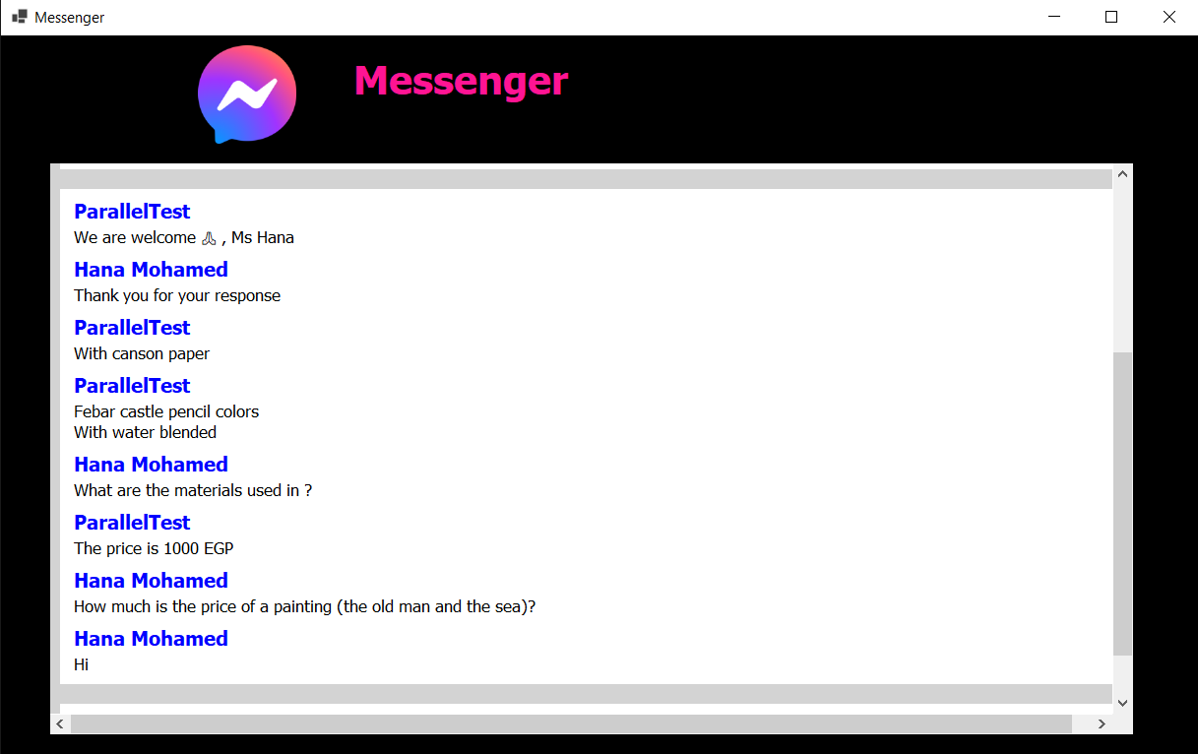
API Fetching from Messenger
Steps:
Use this url to access all your facebook page chats , url: https://graph.facebook.com/v21.0/me/conversations?platform=MESSENGER&access_token={fb_page_access_token}.
Use this url + conversation id for each chat to access chat’s messages , url: https://graph.facebook.com/v21.0/{conversation_id}?fields=id,messages,senders,message_count&access_token= {fb_page_access_token}.
Use this url + message id for each message to access message text , details , url : https://graph.facebook.com/v21.0/{message_id}?fields=message,id,to,from&access_token= {fb_page_access_token}.

Slide 8

Creative features to enhance the project
Allows users to consume and interact with content without switching between applications.
The design can support user preferences to display only selected content.
Used for business pages.
The retrieved content contains the picture in GUI.

Slide 9
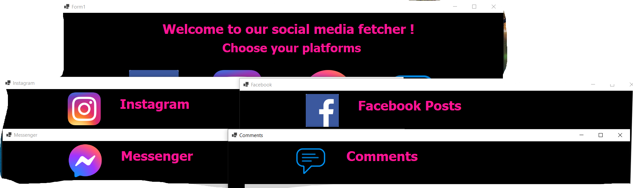
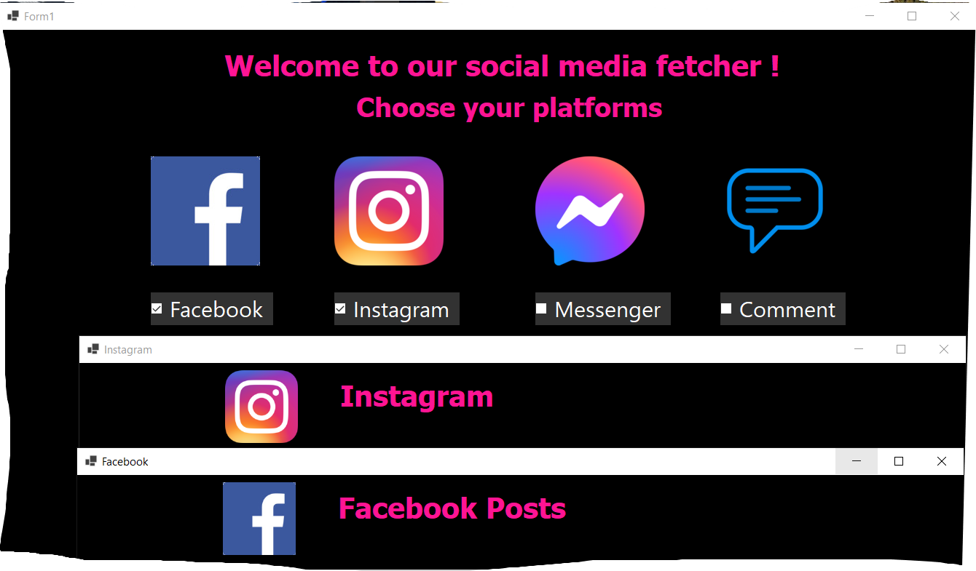
Allows users to consume and interact with content without switching between applications which means you can interact with all platforms in the same place without being distracted by multiple steps to interact with them.
The design can support user preferences to display only selected content , so it becomes easier and faster to interact with the content you want without being forced to see all content of all platforms.

Slide 10
The retrieved content contains the picture in GUI , as you can see

Slide 11
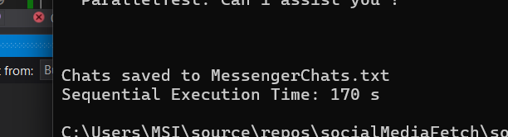
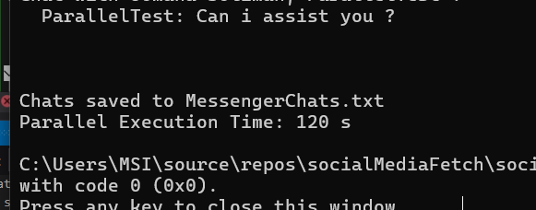
Sequential ( single_threaded ) vs Parallel ( multithreaded ) :
Sequential processing : A single thread/process completes one task before moving to the next, and There is no overlap between tasks. Which makes it simpler and easier to implement , but may be slow if tasks are independent and can run concurrently, as performance is limited to one core/CPU thread.
Parallel processing : Tasks are broken into subtasks that run concurrently using multiple threads, threads can execute on different CPU cores or share time slices on a single core (multithreading), so it represents faster execution for tasks that are independent and CPU-bound due to concurrent execution, as performance scales with the number of available CPU cores and threads.

Slide 12
Sequential vs parallel
Feature | Sequential processing | Parallel processing
Speed | Slower for independent tasks | Faster for parallelizable tasks
Complexity | Simple to implement | Requires careful thread management
Scalability | Limited to single-core | Scales with cores/threads
Debugging | Easier to debug | More challenging

Slide 13

Thank you
Toqa Abu Al fotoh
Jomana Mohammed
Hana Mohammed
Toqa Assem
Omar Morshedy
Osama Samir

